Slide 1
Wind Energy Conversion Systems Assignment # 2
M.Shamaas
2018-MS-EE-4

Slide 2
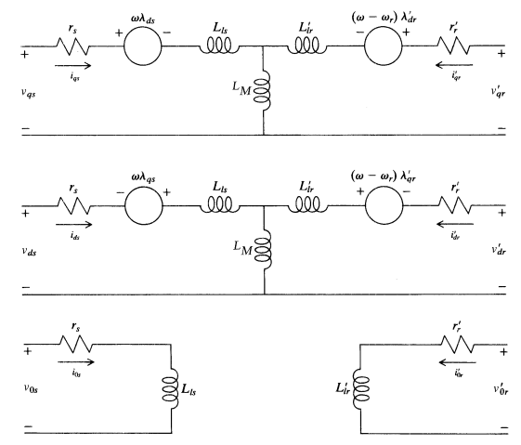
SCIG d-, q- and 0-axis Circuit Diagrams

Slide 3
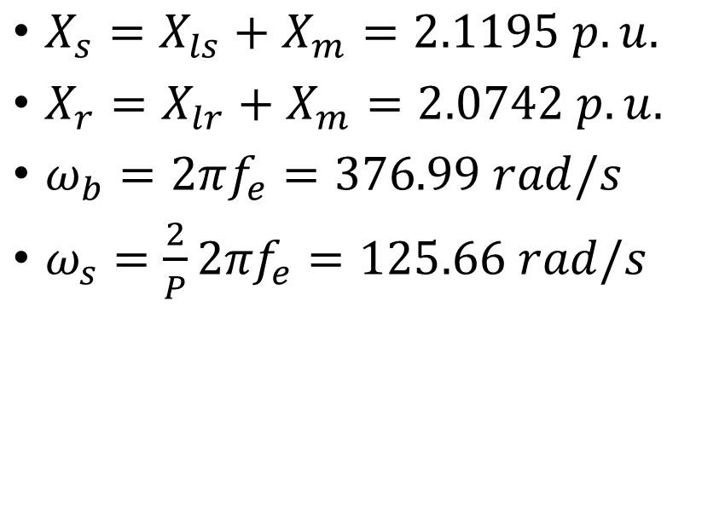
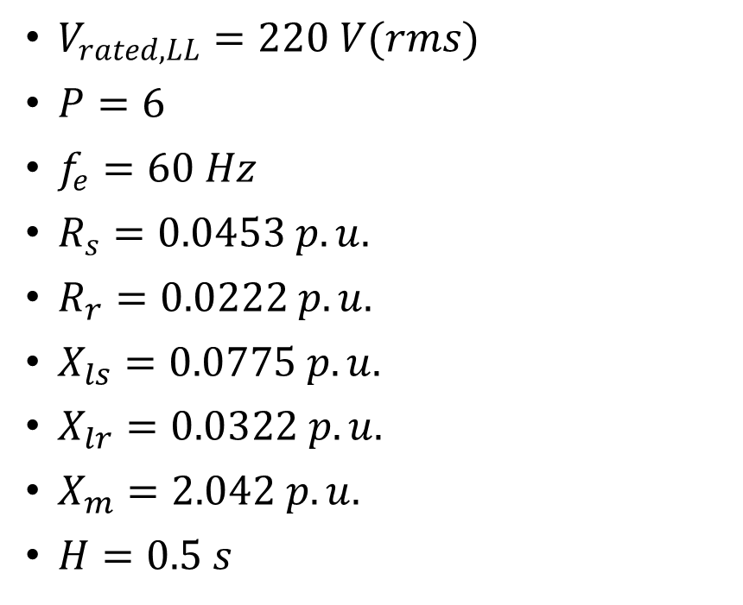
Free acceleration of a singly excited SCIG
Given Machine Constants
Calculated Machine Constants
$V_{rated,LL}=220 V(rms)$
$P=6$
$f_{e}=60 Hz$
$R_{s}=0.0453 p.u.$
$R_{r}=0.0222 p.u.$
$X_{ls}=0.0775 p.u.$
$X_{lr}=0.0322 p.u.$
$X_{m}=2.042 p.u.$
$H=0.5 s$
$X_{s}=X_{ls}+X_{m}=2.1195 p.u.$
$X_{r}=X_{lr}+X_{m}=2.0742 p.u.$
$ω_{b}=2πf_{e}=376.99 rad/s$
$ω_{s}=\frac{2}{P}{2πf}_{e}=125.66 rad/s$

Slide 4
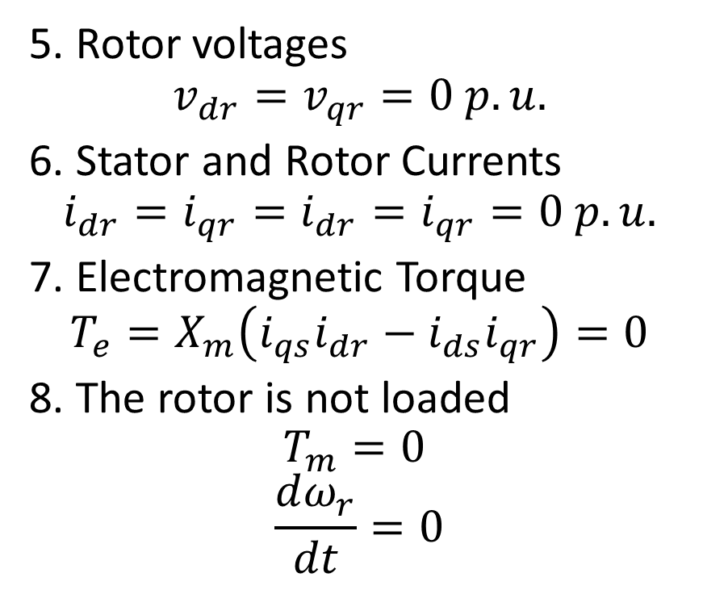
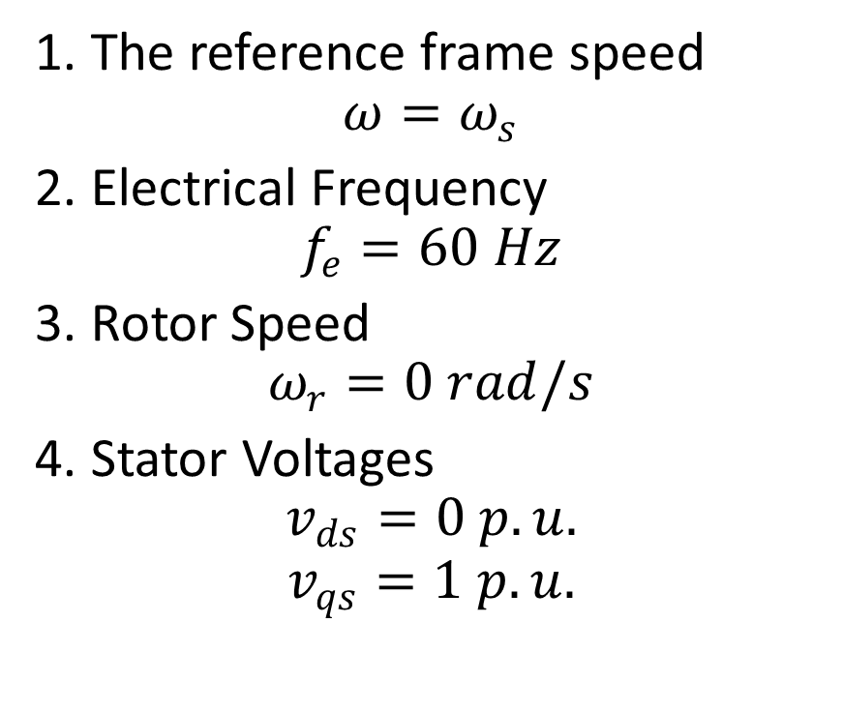
Initial Conditions (t = 0-)
1. The reference frame speed
$$ω=ω_{s}$$
2. Electrical Frequency
$$f_{e}=60 Hz$$
3. Rotor Speed
$$ω_{r}=0 rad/s$$
4. Stator Voltages
$$v_{ds}=0 p.u.$$
$$v_{qs}=1 p.u.$$
5. Rotor voltages
$$v_{dr}=v_{qr}=0 p.u.$$
6. Stator and Rotor Currents
$$i_{dr}=i_{qr}=i_{dr}=i_{qr}=0 p.u.$$
7. Electromagnetic Torque
$$T_{e}=X_{m}\left(i_{qs}i_{dr}−i_{ds}i_{qr}\right)=0$$
8. The rotor is not loaded
$$T_{m}=0$$
$$\frac{dω_{r}}{dt}=0$$

Slide 5

Voltage Equations
$$\left[\begin{matrix}\begin{matrix}v_{qs} \\ v_{ds} \\ v_{0s}\end{matrix} \\ \begin{matrix}v_{qr} \\ v_{qr} \\ v_{0r}\end{matrix}\end{matrix}\right]=\left[\begin{matrix}\begin{matrix} R_{s}+\frac{p}{ω_{b}}X_{s} & \frac{ω_{s}}{ω_{b}}X_{s} & 0 \\ −\frac{ω_{s}}{ω_{b}}X_{s} & R_{s}+\frac{p}{ω_{b}}X_{s} & 0 \\ 0 & 0 & R_{s}+\frac{p}{ω_{b}}X_{ls}\end{matrix} & \begin{matrix}\frac{p}{ω_{b}}X_{m} & \frac{ω_{s}}{ω_{b}}X_{s} & 0 \\ −\frac{ω_{s}}{ω_{b}}X_{m} & \frac{p}{ω_{b}}X_{m} & 0 \\ 0 & 0 & 0\end{matrix} \\ \begin{matrix}\frac{p}{ω_{b}}X_{m} & \frac{ω_{s}−ω_{r}}{ω_{b}}X_{m} & 0 \\ −\frac{ω_{s}−ω_{r}}{ω_{b}}X_{m} & \frac{p}{ω_{b}}X_{m} & 0 \\ 0 & 0 & 0\end{matrix} & \begin{matrix}R_{r}+\frac{p}{ω_{b}}X_{r} & \frac{ω_{s}−ω_{r}}{ω_{b}}X_{r} & 0 \\ −\frac{ω_{s}−ω_{r}}{ω_{b}}X_{r} & R_{r}+\frac{p}{ω_{b}}X_{r} & 0 \\ 0 & 0 & R_{r}+\frac{p}{ω_{b}}X_{lr}\end{matrix}\end{matrix}\right]\left[\begin{matrix}\begin{matrix}i_{qs} \\ i_{ds} \\ i_{0s}\end{matrix} \\ \begin{matrix}i_{qr} \\ i_{dr} \\ i_{0r}\end{matrix}\end{matrix}\right]$$

Slide 6

Current Equations
$$\left[\begin{matrix}\begin{matrix}{pi}_{qs} \\ {pi}_{ds} \\ {pi}_{0s}\end{matrix} \\ \begin{matrix}{pi}_{qr} \\ {pi}_{dr} \\ {pi}_{0r}\end{matrix}\end{matrix}\right]=B\left[\begin{matrix}\begin{matrix}v_{qs} \\ v_{ds} \\ v_{0s}\end{matrix} \\ \begin{matrix}v_{qr} \\ v_{qr} \\ v_{0r}\end{matrix}\end{matrix}\right]+A\left[\begin{matrix}\begin{matrix}i_{qs} \\ i_{ds} \\ i_{0s}\end{matrix} \\ \begin{matrix}i_{qr} \\ i_{dr} \\ i_{0r}\end{matrix}\end{matrix}\right] where B={\left[\begin{matrix}\begin{matrix} \frac{1}{ω_{b}}X_{s} & 0 & 0 \\ 0 & \frac{1}{ω_{b}}X_{s} & 0 \\ 0 & 0 & \frac{1}{ω_{b}}X_{ls}\end{matrix} & \begin{matrix}\frac{1}{ω_{b}}X_{m} & 0 & 0 \\ 0 & \frac{1}{ω_{b}}X_{m} & 0 \\ 0 & 0 & 0\end{matrix} \\ \begin{matrix}\frac{1}{ω_{b}}X_{m} & 0 & 0 \\ 0 & \frac{1}{ω_{b}}X_{m} & 0 \\ 0 & 0 & 0\end{matrix} & \begin{matrix} \frac{1}{ω_{b}}X_{r} & 0 & 0 \\ 0 & \frac{1}{ω_{b}}X_{r} & 0 \\ 0 & 0 & \frac{1}{ω_{b}}X_{lr}\end{matrix}\end{matrix}\right]}^{−1}$$
and $A=−B\left[\begin{matrix}\begin{matrix}R_{s} & \frac{ω_{s}}{ω_{b}}X_{s} & 0 \\ −\frac{ω_{s}}{ω_{b}}X_{s} & R_{s} & 0 \\ 0 & 0 & { R}_{s}\end{matrix} & \begin{matrix}0 & \frac{ω_{s}}{ω_{b}}X_{s} & 0 \\ −\frac{ω_{s}}{ω_{b}}X_{m} & 0 & 0 \\ 0 & 0 & 0\end{matrix} \\ \begin{matrix} 0 & \frac{ω_{s}−ω_{r}}{ω_{b}}X_{m} & 0 \\ −\frac{ω_{s}−ω_{r}}{ω_{b}}X_{m} & 0 & 0 \\ 0 & 0 & 0\end{matrix} & \begin{matrix} R_{r} & \frac{ω_{s}−ω_{r}}{ω_{b}}X_{r} & 0 \\ −\frac{ω_{s}−ω_{r}}{ω_{b}}X_{r} & R_{r} & 0 \\ 0 & 0 & R_{r}\end{matrix}\end{matrix}\right]$

Slide 7
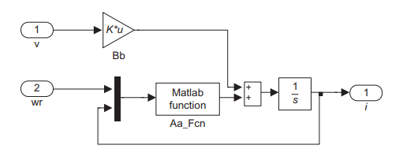
Current Equation

Slide 8
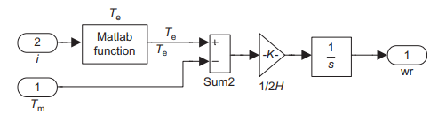

Motion and Torque Equations
1. $\frac{ω_{r}}{ω_{b}}=\frac{1}{2HS}\left(T_{e}−T_{m}\right)$
2. $T_{e}=X_{m}(i_{qs}i_{dr}−i_{ds}i_{qr})$

Slide 9
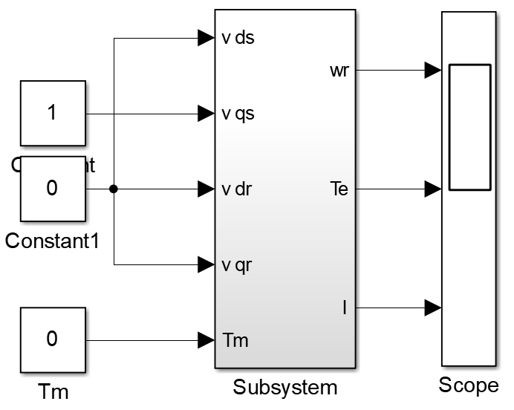
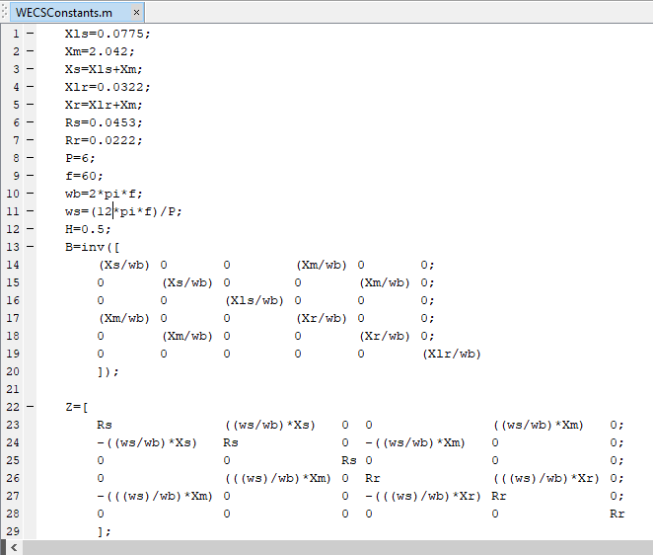
Free Acceleration Model

Slide 10
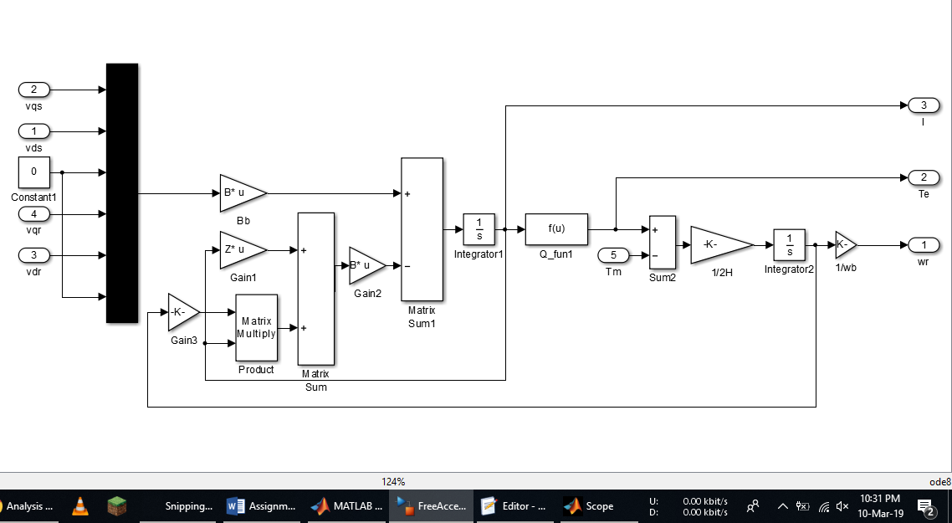
SCIG Machine Model

Slide 11
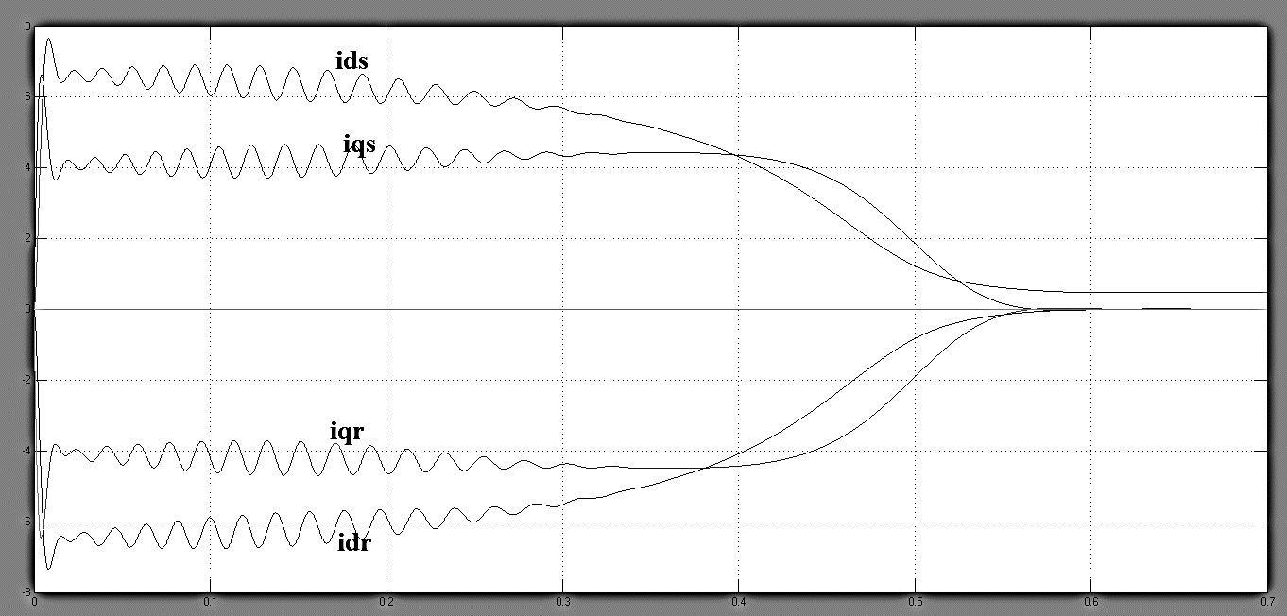
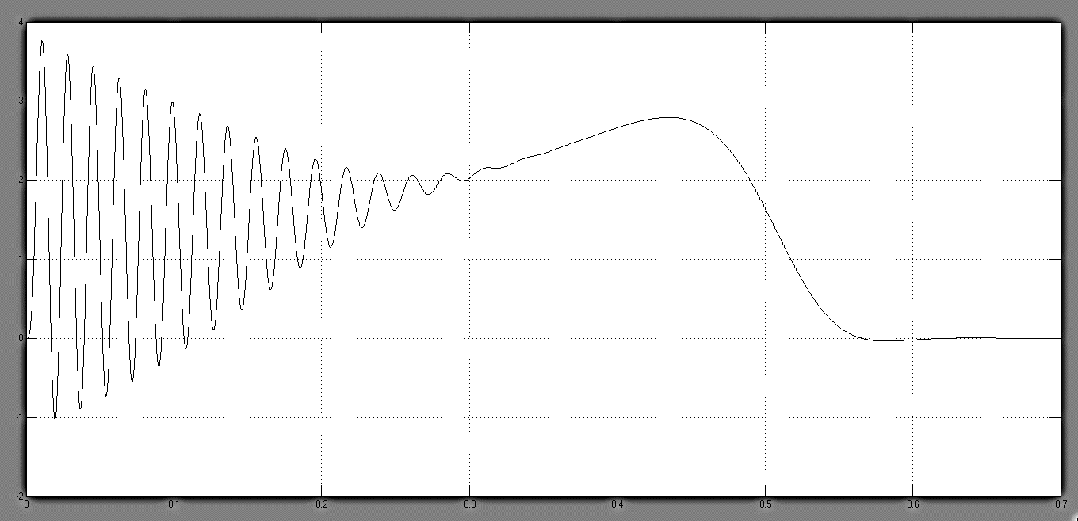
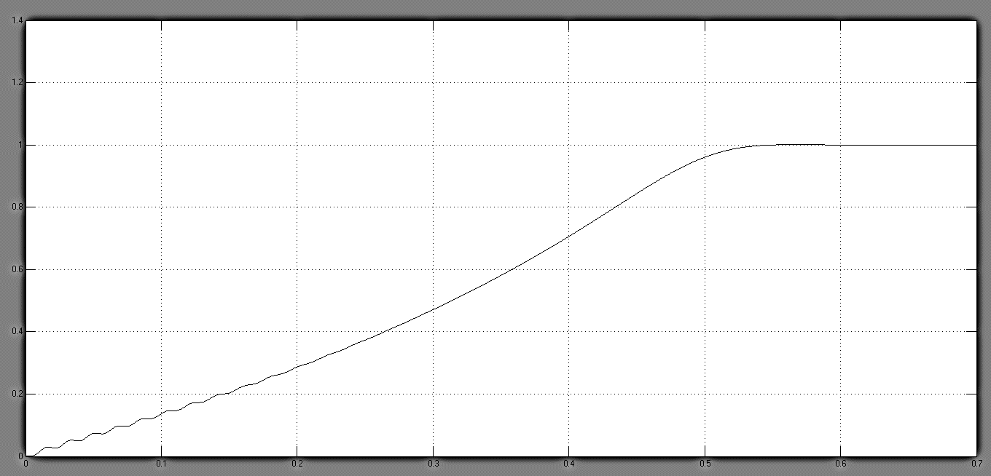
Currents, Torque and Rotor Speed

